Slide 1
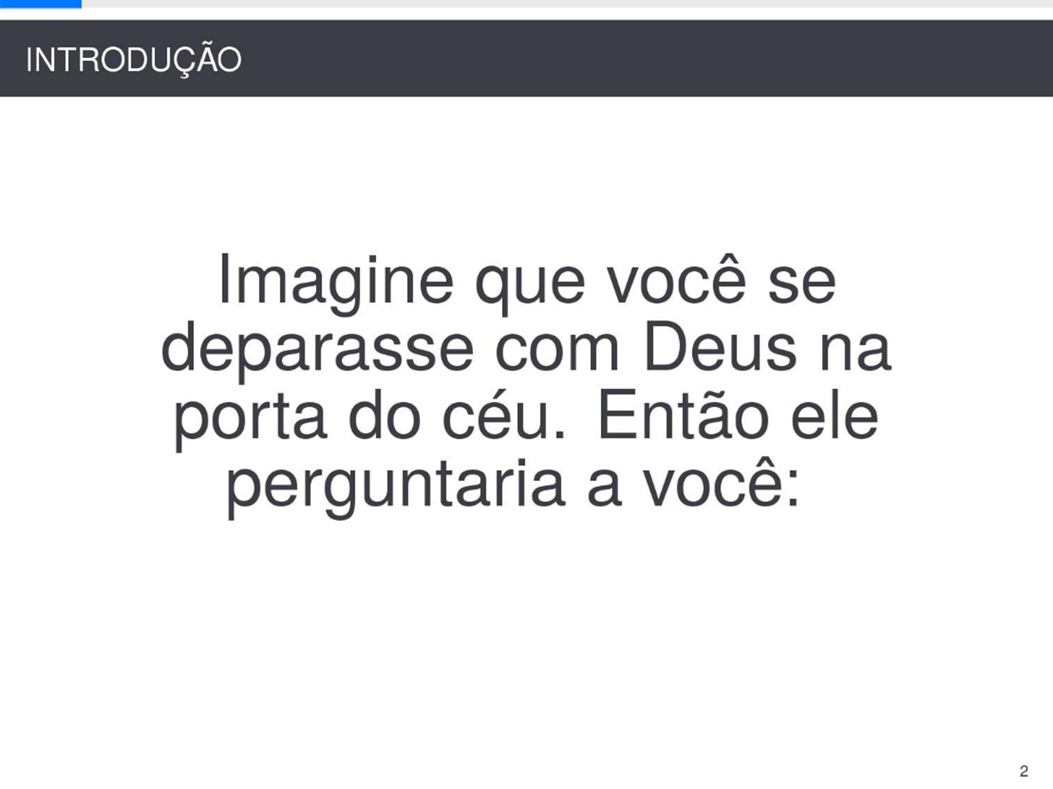
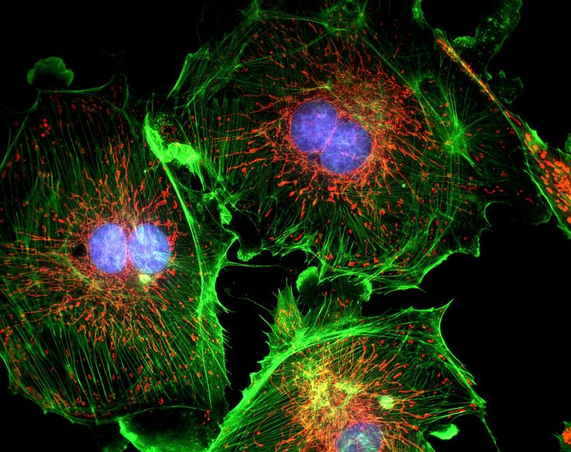
FPGA-based fluorescence microscope
Bring real time to multi-channel microscope
Yi Zhang Zhihao Yuan Tianzhi Wu

Slide 2
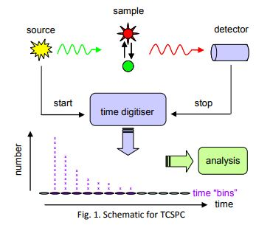
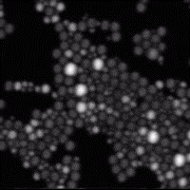
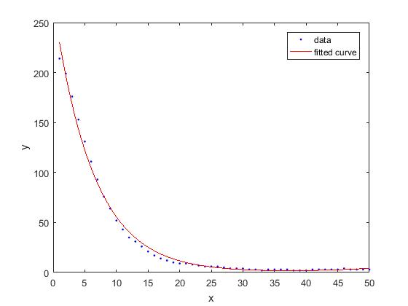

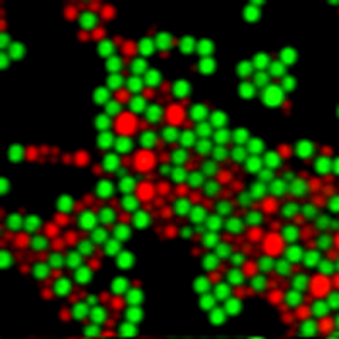
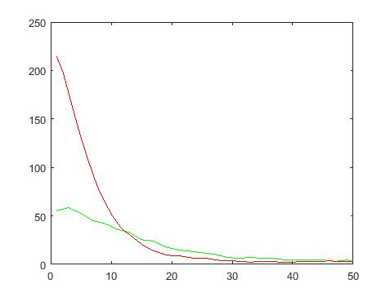


Goals and big picture
I = 270 $e^{−0.158}$
Fluorescence lifetime imaging
Amplitude
Fluorescence working principle
The decay curve can be described by exponential function.
For the red beads: $τ=6.33$
For the green beads: $τ$ = $22.12$
The $I_{0}$ can not be used as a criteria, because in general it is decided by the concentration rather than chemical property.
Time ns
Off-line processed by MATLAB
Different components have different lifetime
Our goal is separate different components based on fluorescence lifetime and display it.

Slide 3
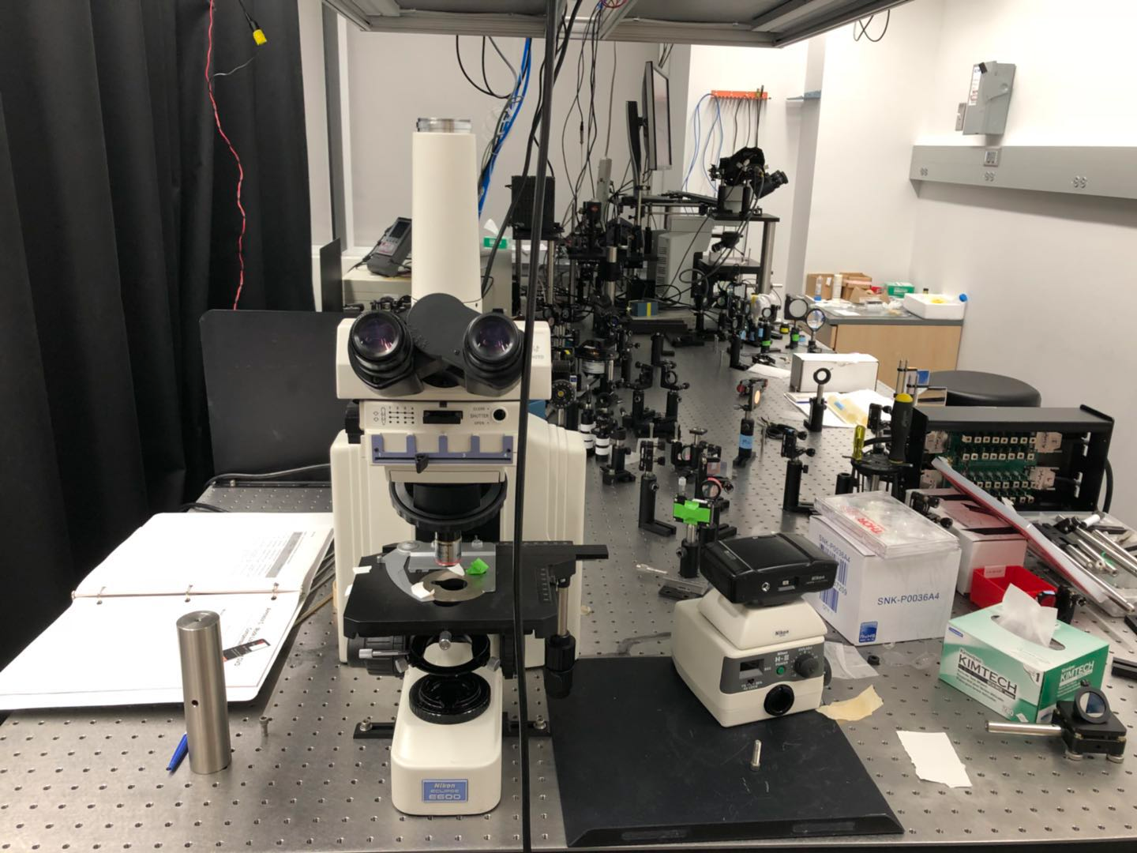
System Setup
monitor
VGA interface
We got the life time here
SD card
SD interface
Signal
Process
Classifier
&Pseudo color
Raw data Taken from Microscope is store here
FPGA
Display memory
Raw Data
SRAM
SRAM

Slide 4
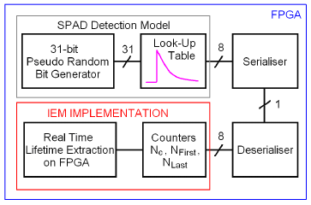
Current State of Project
Finished Parts:
1. serialiser & deserialiser
2. Signal process (part used to calculate lifetime, in picture, counter)
3. 31-bit pseduo radom generator & look up table
these parts are used to test 1 & 2
4. VGA display interface
Classifier
&Pseudo color

Slide 5
Current State of Project
Modules in progress:
1. SDcard interface
Read data from SDcard and store it in SRAM on FPGA
problems & difficulty:
- not fimliar with reading SDcard on board
2. test of whole signal process block

Slide 6
Current State of Project
Not started yet:
1. classifier pesduo color
Read data from SDcard and store it in SRAM on FPGA
2. Cache interface
they will be used to store data from SDcard and output image

Slide 7
Time line
Week/group member | 3/27-4/1 | 4/2-4/8 | 4/9-4/15 | 4/16-4/24
Yi Zhang | SRAM | VGA interface | VGA display and integrate with system
Tianzhi Wu | SD- Card interface and SRAM connection | SD- Card interface and SRAM connection | test & Integrate with system
Zhihao Yuan | Signal Process | Pseudo Color | Classifier Integrate with System
Group |  |  | Integration | System test Process more data

Slide 8


THANK YOU!

